Slide 1

EMOTION RECOGNITION AND SENTIMENT ANALYSIS FOR RELATIONSHIP IMPROVEMENT
TMP-2023-24-133

Slide 2


INTRODUCTION
There are four basic types of relationships: family relationships, friendships, acquaintanceships, and romantic relationships.
Relationship breakdown is a prevalent issue globally, with divorce rates ranging from 40% to 50% in developed countries.
Cohabitation rates have increased, and non-marital relationships also face challenges, with around 25% to 40% ending in breakups within the first year.
In addition, other relationship breakdowns in the world are increasing rapidly.
We are creating a mobile app that is a more accurate and modern way to strengthen these relationships

Slide 3
RESEARCH QUESTION
RESEARCH
QUESTION
How to find out if a person is stressed due to relationship breakdown?
Using sentiment analysis , what mental state are they in?
3. How AI can be used to rebuild their relationship?

Slide 4

MAIN OBJECTIVE
SUB OBJECTIVE
The use of mobile phones has become very popular in the developing world. There are currently 7.33 billion mobile phone users in the world. Therefore, we decided to find a solution to the problems caused by the breakdown of relationships using new technology. Accordingly, our hope is to create a new mobile phone application using AI technology for identify and improve their relationship.
01 - Enhancing Emotion Recognition through Image-based Art Therapy for Relationship Breakdown Recovery
02 - Sentiment Analysis Implementation
03 - User Testing and Ethical Considerations
04 - AI Powered AR/VR Character

Slide 5
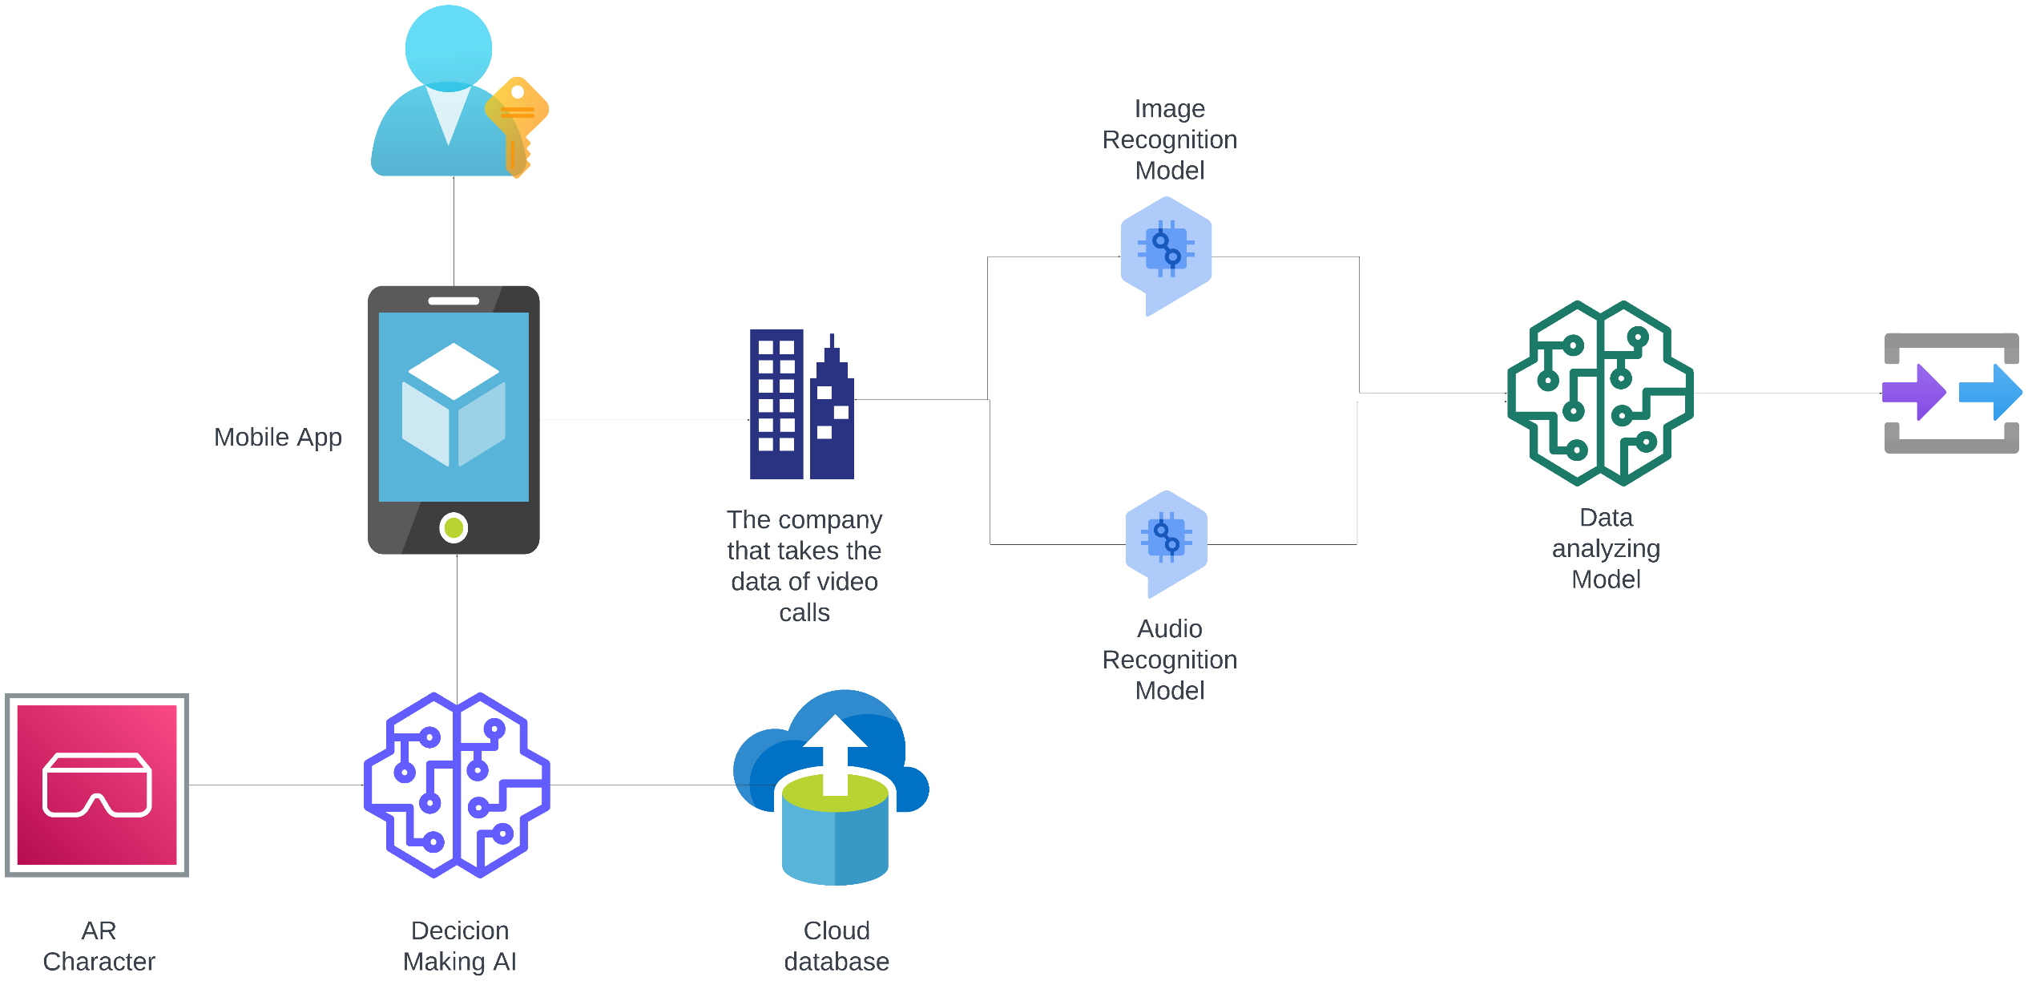
OVERALL SYSTEM DIAGRAM

Slide 6

DESIGN AI POWERD
AR CHRACTER
IT20647414
AYESH BATADUWAARACHCHI
INFORMATION TECHNOLOGY

Slide 7

INTRODUCTION
Creating an AI to analyse the data entered by the user and exchange ideas according to the user's wishes.
A VR character is created according to the data of the AI ​​created above.
We train that character to communicate with user and getting much closer to the user and identify feelings.
IT20647414 | BATADUWAARACHCHI A.I | TMP-2023-24-133

Slide 8

RESEARCH PROBLEM
How to get user's data to give prediction from AI?
A questionnaire is created to collect data from the user and identify the need of the user properly. If the user is not able to provide data, the options provided through the app can be used.
How can AR characters more accurately build conversations with the user?
The relevant AR character is trained using a large dataset.
IT20647414 | BATADUWAARACHCHI A.I | TMP-2023-24-133

Slide 9

SUB OBJECTIVE
Create a questionnaire to collect data from the user
Creating an AI that can use that data to make more accurate predictions
Creating an AR character that can take data from Ai and interact with the user
Training the AR character using the data so that the AR character can deal more closely with the user's emotions
IT20647414 | BATADUWAARACHCHI A.I | TMP-2023-24-133

Slide 10
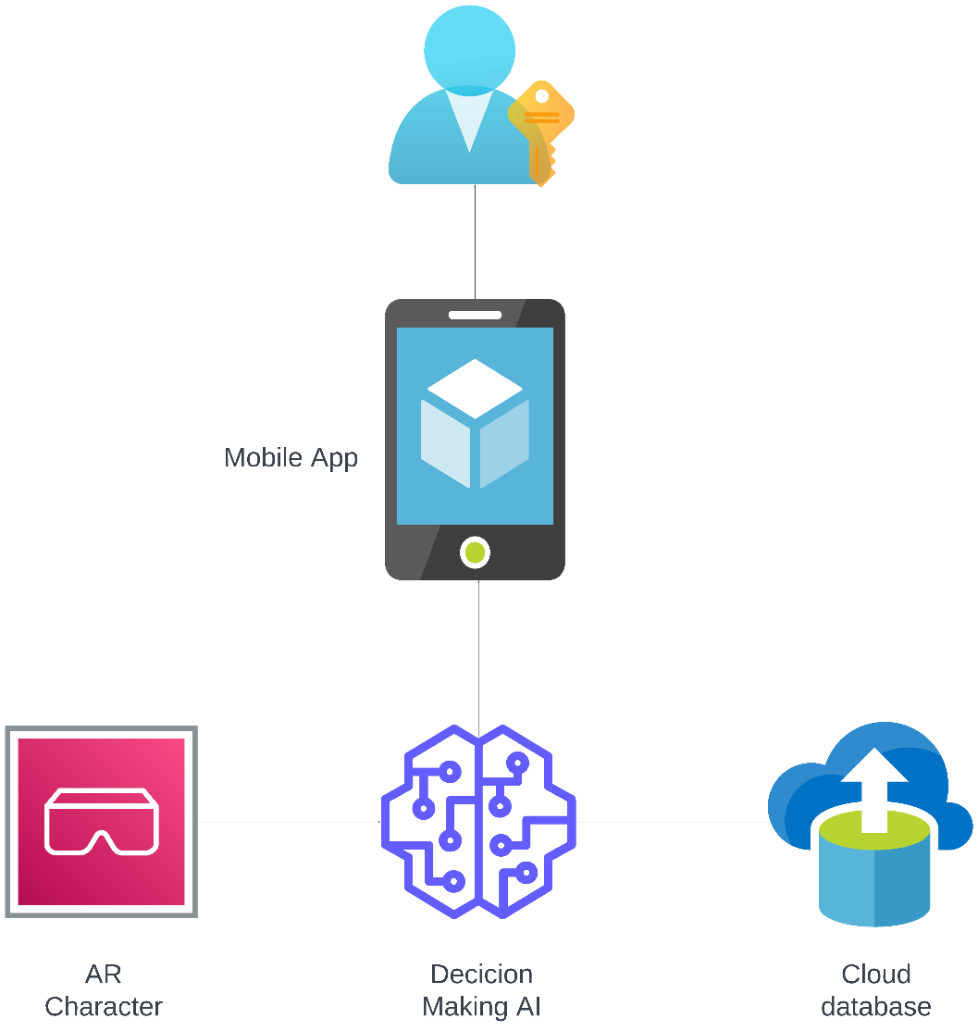
SYSTEM DIAGRAM
IT20647414 | BATADUWAARACHCHI A.I | TMP-2023-24-133

Slide 11




TECHNOLOGIES TO BE USED
NLP
ARCore
Google Text-to-Speech
TenserFlow
GIT
IT20647414 | BATADUWAARACHCHI A.I | TMP-2023-24-133

Slide 12

SYSTEM SPECIFICATION
FUNCTIONAL
Real-time Emotional Responses
Augmented Reality Integration
Customization Options
Diverse Emotional Expressions
NON - FUNCTIONAL
Performance
AR Rendering Quality
Usability and Accessibility
Learning Efficiency
IT20647414 | BATADUWAARACHCHI A.I | TMP-2023-24-133

Slide 13
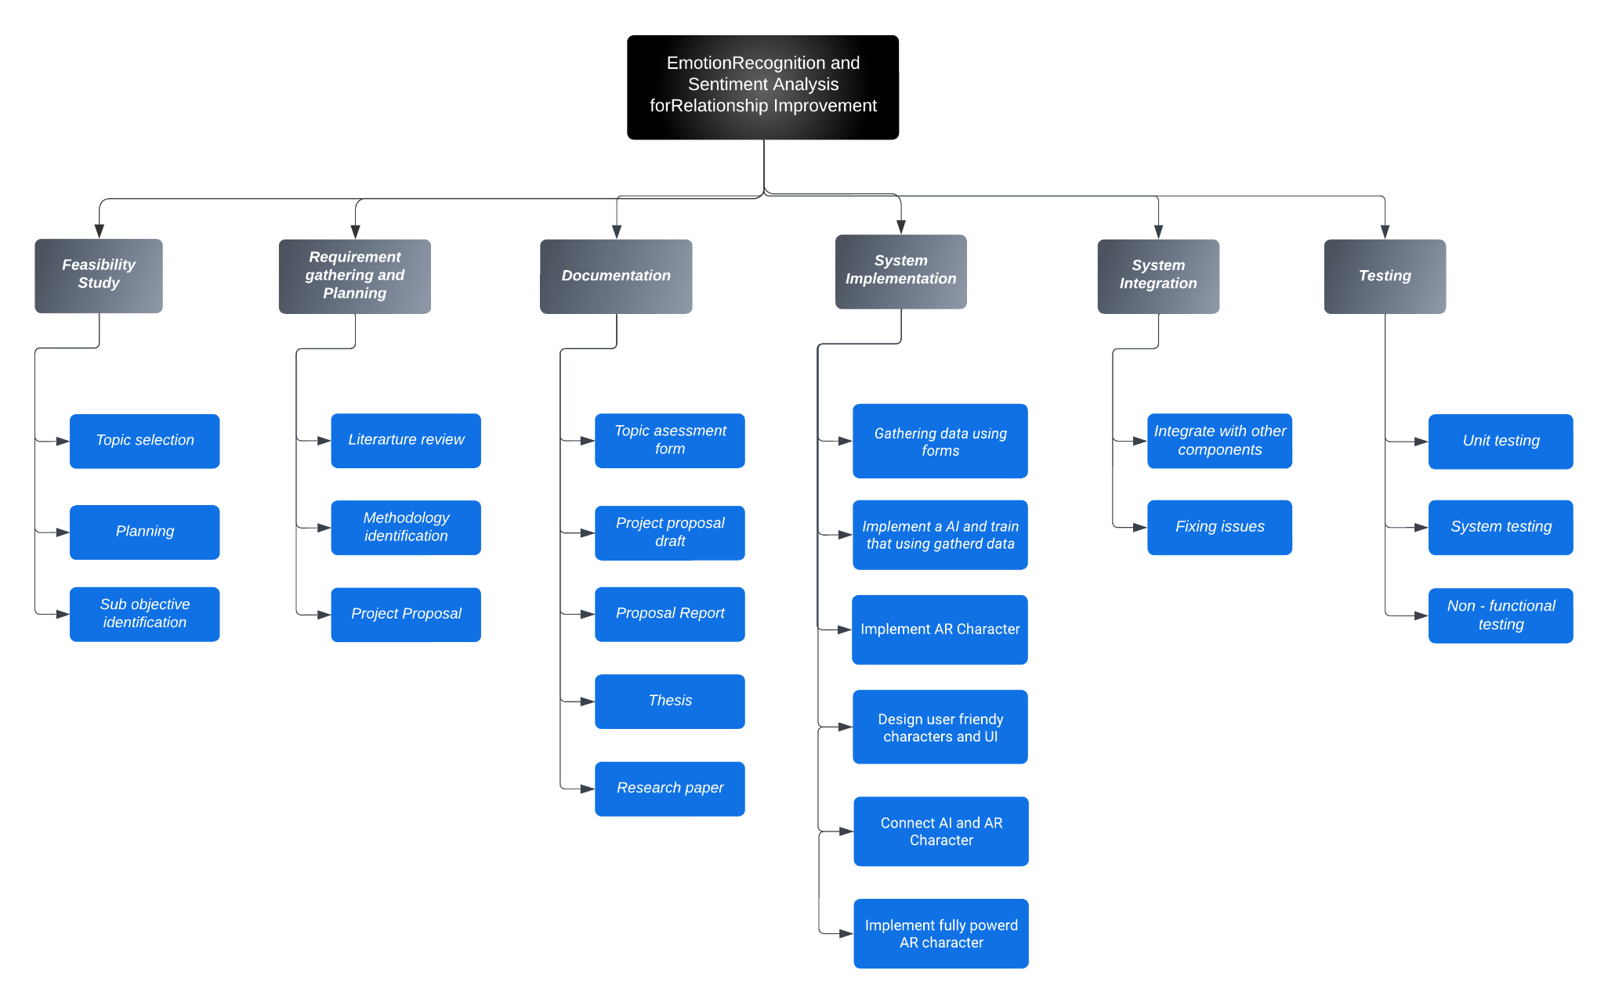
WORK BRAKEDOWN CHART
IT20647414 | BATADUWAARACHCHI A.I | TMP-2023-24-133

Slide 14
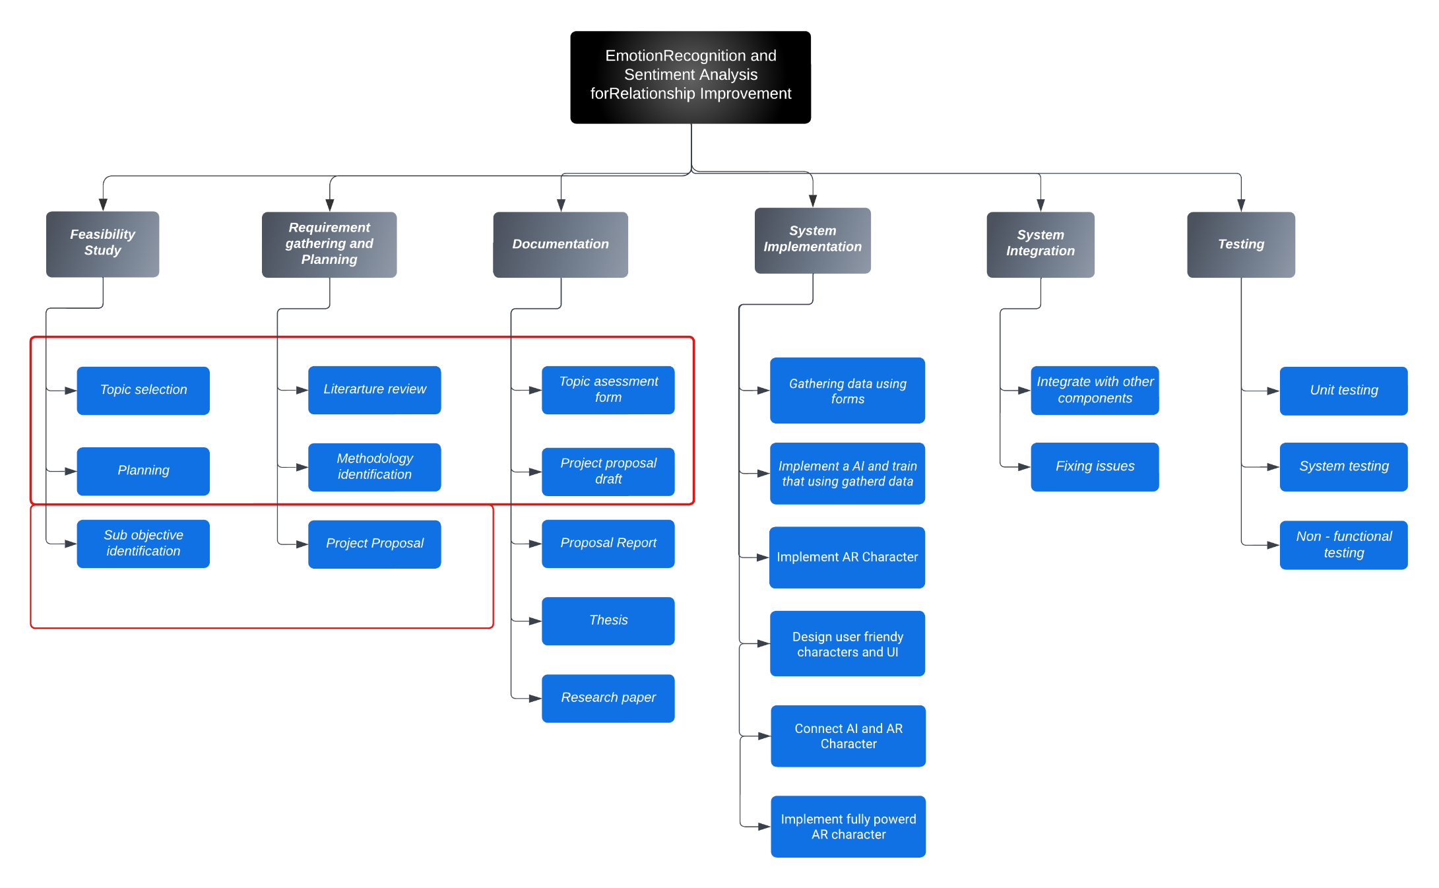
COMPLETION OF THE PROJECT
IT20647414 | BATADUWAARACHCHI A.I | TMP-2023-24-133

Slide 15

RECOGNIZE AN EMOTION USING IMAGE PROCESSING
IT20651442
DILINI GAMAGE
INFORMATION TECHNOLOGY

Slide 16
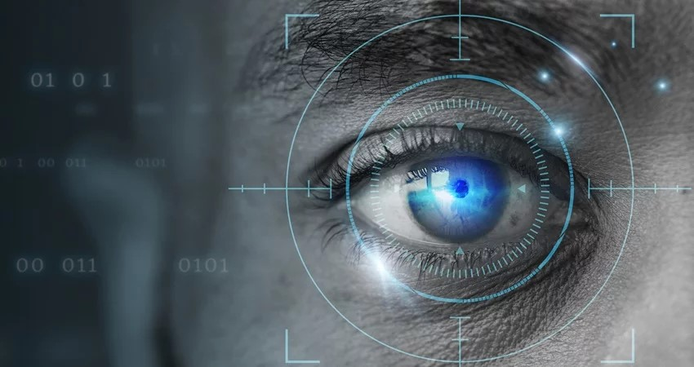
INTRODUCTION
Develop a model that analyses facial expressions to understand the emotions of users
The app empowers users to express emotions, track progress, set goals, and build resilience in a supportive environment.
IT20651442 | CHANIKA DILINI | TMP-2023-24-133

Slide 17
RESEARCH PROBLEM
How to identify the user emotions?
Image processing can capture the user's facial expressions and emotions but may not provide a definitive representation of their fixed emotional state. Emotions are complex and can change over time.
Therefore, we collect the number of blinks, body movements and behavior of the relevant person in relation to the relevant frames.
IT20651442 | CHANIKA DILINI | TMP-2023-24-133

Slide 18
SUB OBJECTIVE
Implement system to gather video call feed
Develop Emotion Recognition Model.
Train that model using dataset
Goal Tracking and Emotional Growth
IT20651442 | CHANIKA DILINI | TMP-2023-24-133

Slide 19
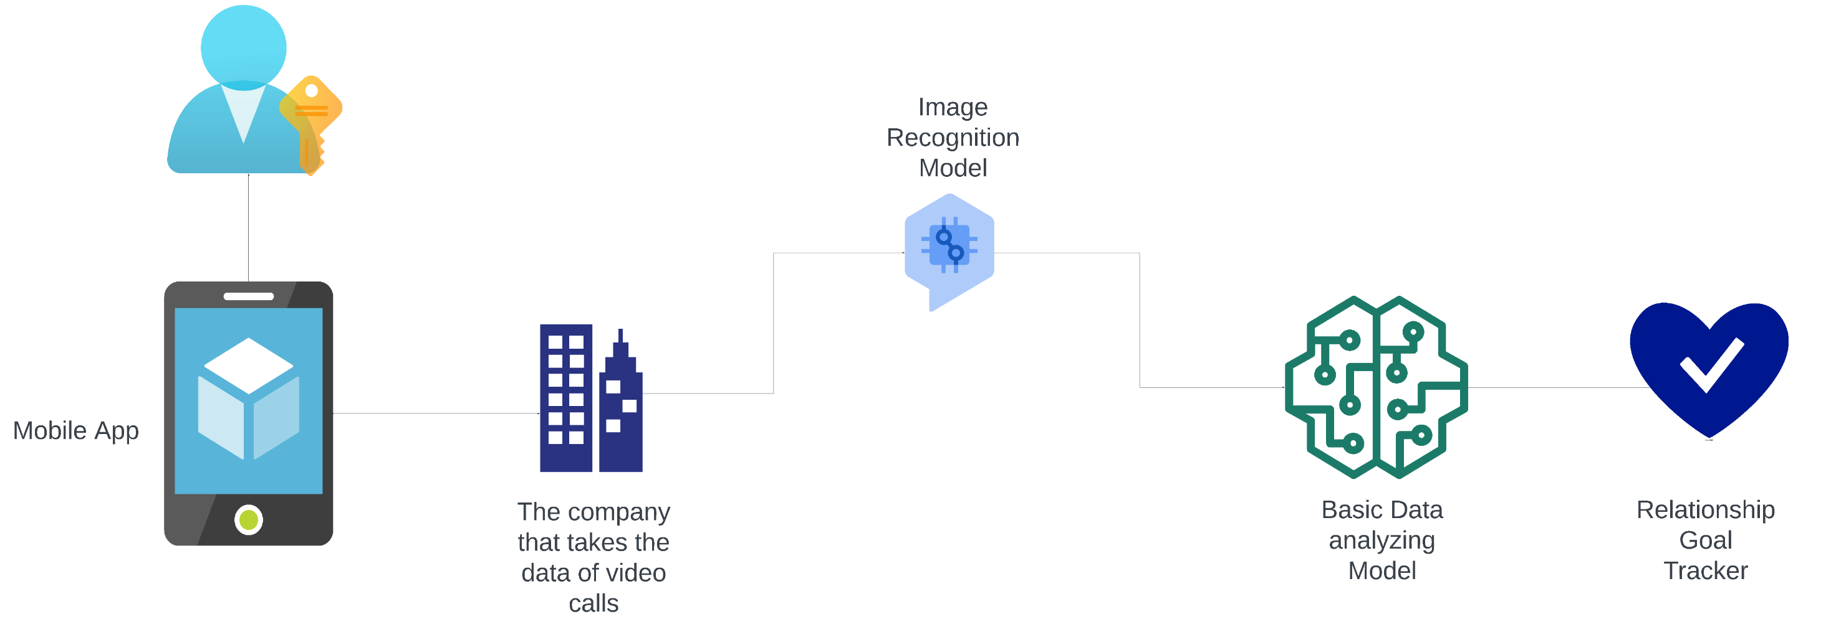
SYSTEM DIAGRAM
IT20651442 | CHANIKA DILINI | TMP-2023-24-133

Slide 20




TECHNOLOGIES TO BE USED
OpenCV
NLTK(Natural Language Toolkit)
Text Blob
Ffmpeg
Media Pipe
Microsoft Azure Cognitive Services
IT20651442 | CHANIKA DILINI | TMP-2023-24-133

Slide 21
SYSTEM SPECIFICATION
FUNCTIONAL
Facial Expression Analysis
Emotion Logging and Tracking
Goal Setting
NON - FUNCTIONAL
Performance
Accuracy and Reliability
User Interface and Accessibility
Offline Functionality
IT20651442 | CHANIKA DILINI | TMP-2023-24-133

Slide 22
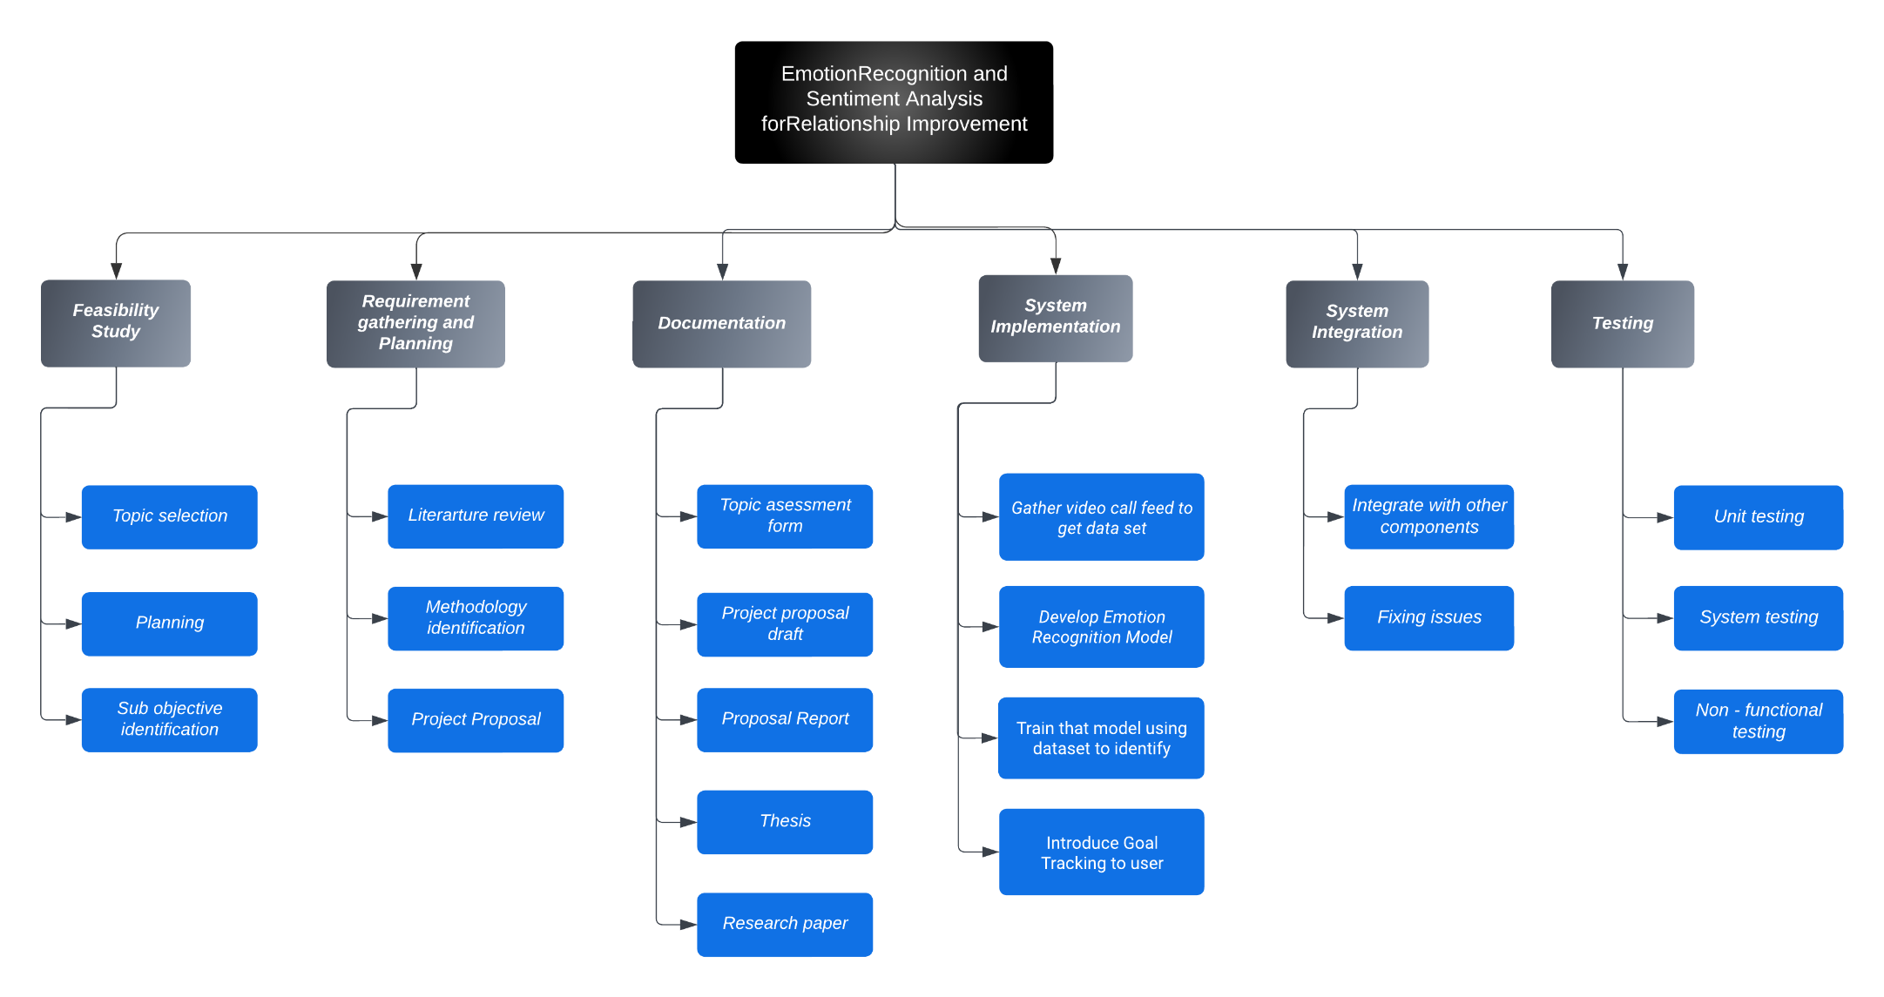
WORK BRAKEDOWN CHART
IT20651442 | CHANIKA DILINI | TMP-2023-24-133

Slide 23
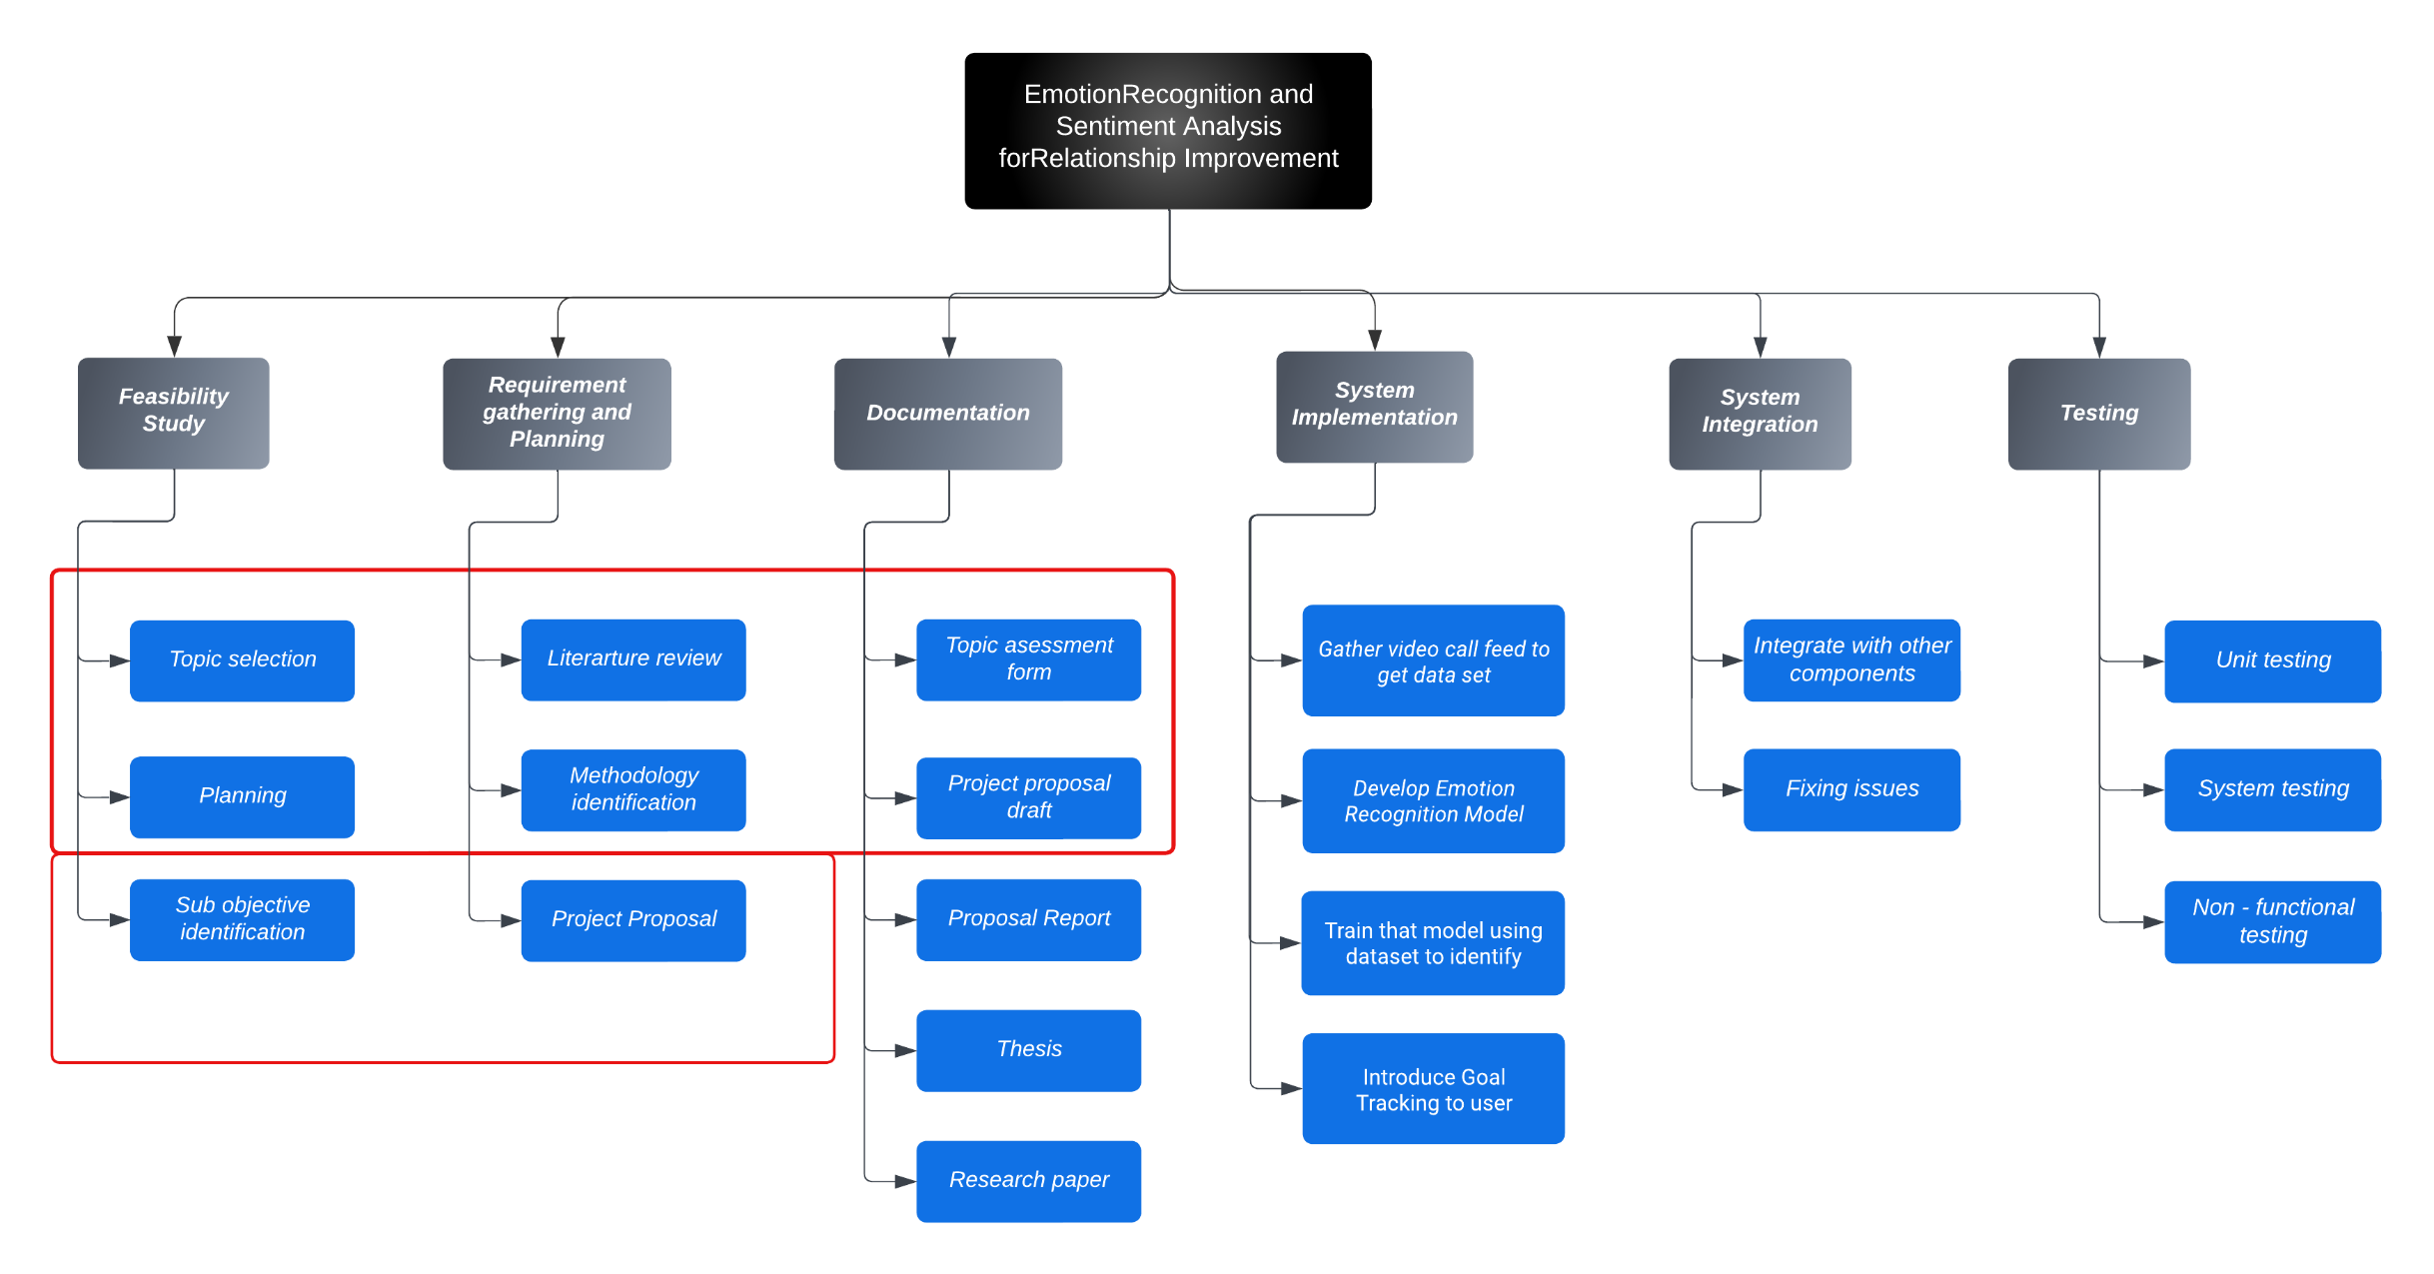
COMPLETION OF THE PROJECT
IT20651442 | CHANIKA DILINI | TMP-2023-24-133

Slide 24

SENTIMENT ANALYSIS
IMPLEMENTATION
IT20648886
SHAKILA DILSHAN
INFORMATION TECHNOLOGY

Slide 25
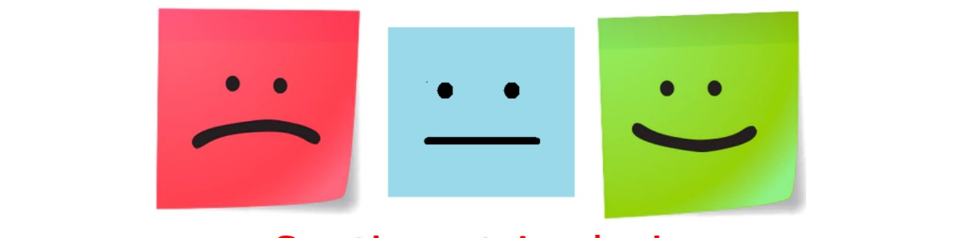
INTRODUCTION
Analyse the data that coming from image processing model and audio recognition model.
Then suggest to the user a game for gather more information about the user that has few stages.
After that, compare those data and generate the solutions for user(ex: suggest a counsiller , generate a advises).
IT20648886 | SHAKILA DILSHAN | TMP-2023-24-133

Slide 26
RESEARCH PROBLEM
If there no data from the image processing model and audio recognition model, how the perform the model ?
developers can manually provide relevant emotional and cognitive information. This enables testing and allows for personalized game recommendations and solutions in the absence of automated data.
IT20648886 | SHAKILA DILSHAN | TMP-2023-24-133

Slide 27
SUB OBJECTIVE
Sentiment Analysis Module
Personalized Relationship Insights and Support
Plan and design the game and game.
Generate and give solutions
IT20648886 | SHAKILA DILSHAN | TMP-2023-24-133

Slide 28
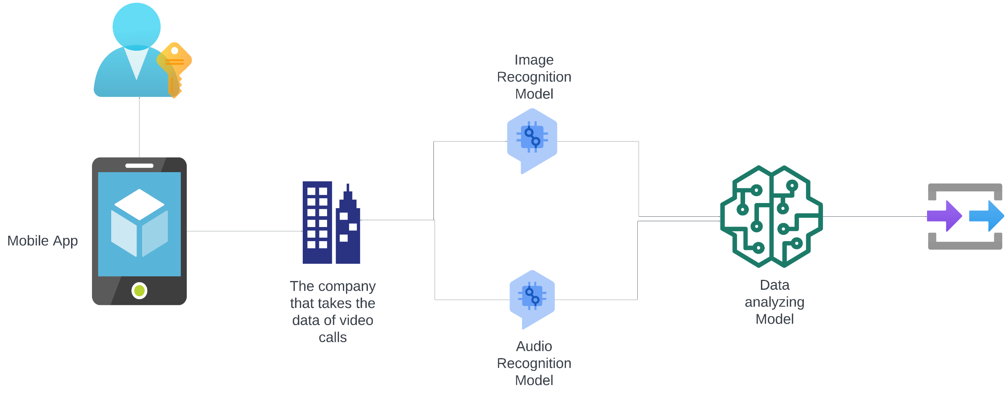
SYSTEM DIAGRAM
IT20648886 | SHAKILA DILSHAN | TMP-2023-24-133

Slide 29


TECHNOLOGIES TO BE USED
Python
NumPy and Pandas
TensorFlow
Phaser
Firebase
Git
IT20648886 | SHAKILA DILSHAN | TMP-2023-24-133

Slide 30
SYSTEM SPECIFICATION
FUNCTIONAL
Sentiment Analysis Model Integration
Multi-Class Sentiment Classification
Customization and Adaptability
NON - FUNCTIONAL
Accuracy and Precision
Scalability and Performance
Privacy and Data Security
IT20648886 | SHAKILA DILSHAN | TMP-2023-24-133

Slide 31
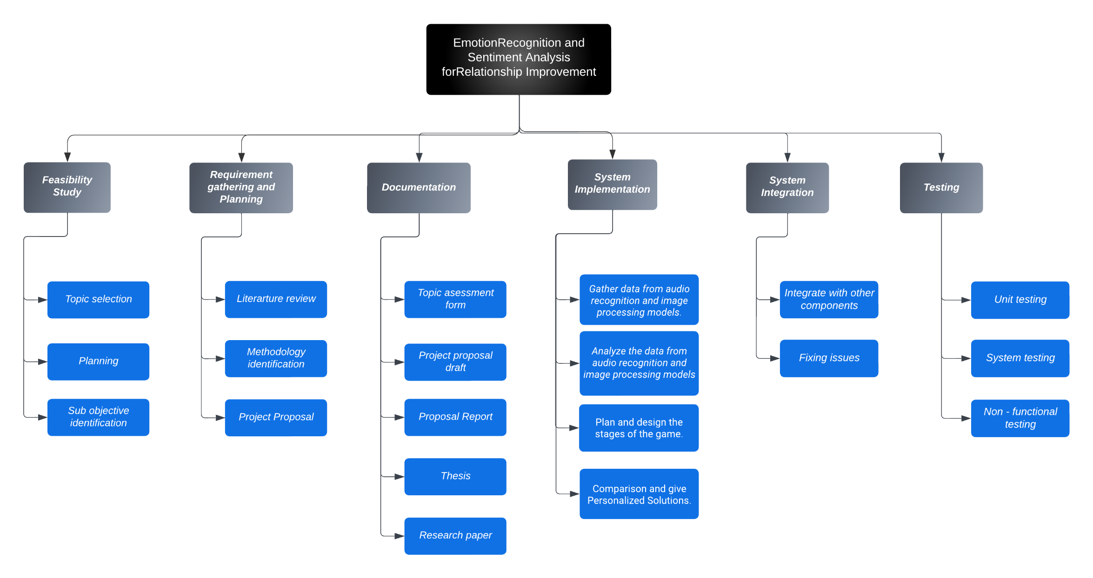
WORK BRAKEDOWN CHART
IT20648886 | SHAKILA DILSHAN | TMP-2023-24-133

Slide 32
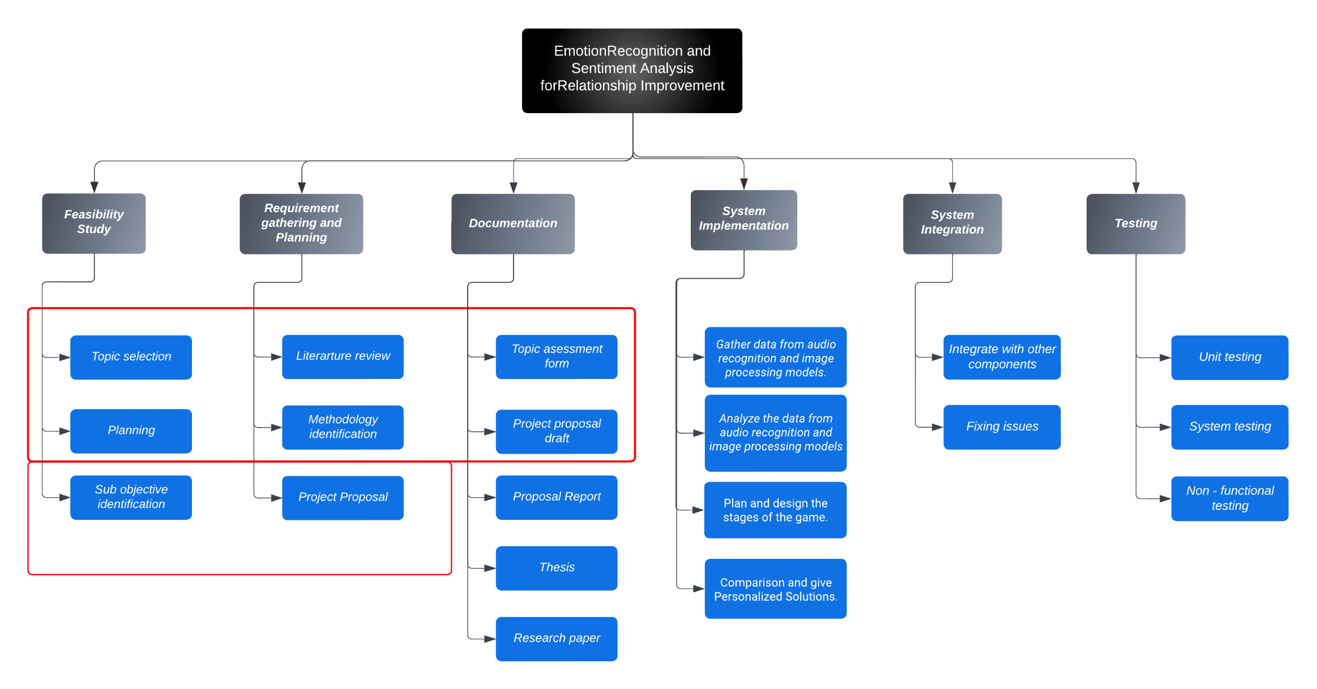
COMPLETION OF THE PROJECT
IT20648886 | SHAKILA DILSHAN | TMP-2023-24-133

Slide 33

AI-ENHANCED AUDIO BASED
EMOTION RECOGNITION
IT20648268
DAMINDU
THIMESHA
Cyber Security

Slide 34

INTRODUCTION
Audio-based emotion recognition and personalized therapy support relationship breakdowns.
Therapy focuses on relationship breakdown recovery through guided meditations, coping strategies.
Advanced emotion recognition and personalized therapy aid in relationship breakdowns.
App promotes emotional healing, resilience, and personal growth through real-time analysis.
IT20648268 | DAMINDU THIMESHA | TMP-2023-24-133

Slide 35
RESEARCH PROBLEM
Improve the accuracy of real-time emotion recognition from users' audio interactions during therapy sessions
Personalize the therapy content to cater to individual users' unique emotional journeys and recovery needs.
Users perceive the ethical implications of audio-based emotion recognition and personalized therapy.
IT20648268 | DAMINDU THIMESHA | TMP-2023-24-133

Slide 36
SUB OBJECTIVE
Implement an accurate and real-time emotion recognition model to analyze emotions from audio interactions during therapy sessions.
Create user profiles to capture emotional journeys, recovery progress, and therapy preferences.
Real-time therapy content adapts to users' emotional responses for immediate support.
Recommend audio therapy sessions based on users' emotional assessments and recovery needs.
Ethically protect audio data and emotional information.
IT20648268 | DAMINDU THIMESHA | TMP-2023-24-133

Slide 37
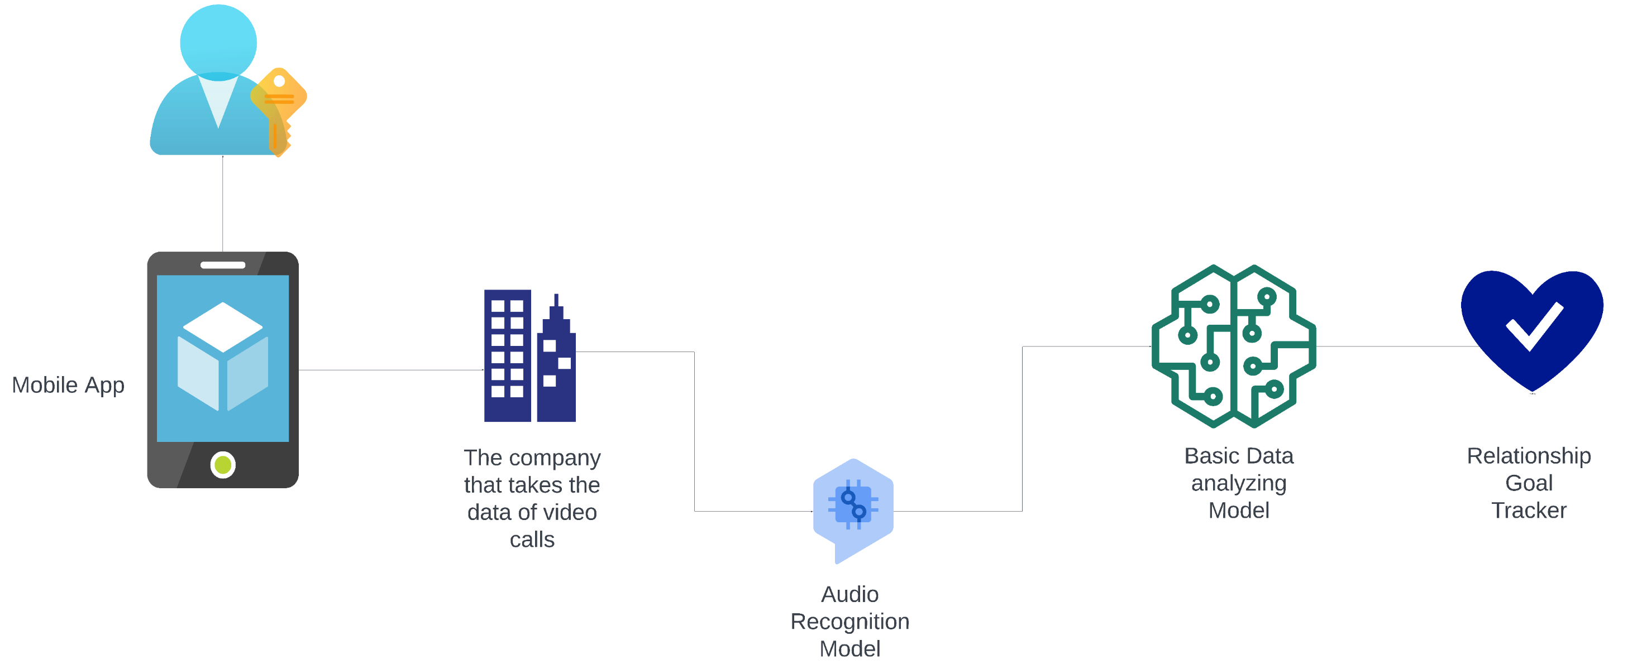
SYSTEM DIAGRAM
IT20648268 | DAMINDU THIMESHA | TMP-2023-24-133

Slide 38



TECHNOLOGIES TO BE USED
PyTorch
Pandas
NumPy
Apache Kafka
PyAudio
Ffmpeg
Librosa
MongoDB
Oauth
AWS
IT20648268 | DAMINDU THIMESHA | TMP-2023-24-133

Slide 39
SYSTEM SPECIFICATION
FUNCTIONAL
Emotion Recognition
Real-Time Content Adaptation
Audio Therapy Playback
User Progress Tracking
NON - FUNCTIONAL
Real-Time Performance
Accuracy and Reliability
Scalability and Performance
Accessibility and Inclusivity
IT20648268 | DAMINDU THIMESHA | TMP-2023-24-133

Slide 40

WORK BRAKEDOWN CHART
IT20648268 | DAMINDU THIMESHA | TMP-2023-24-133

Slide 41
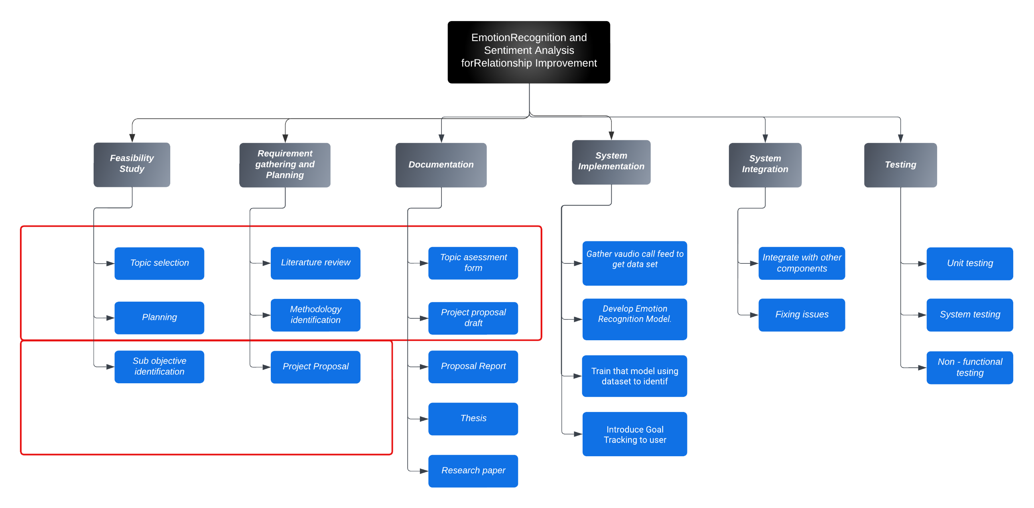
COMPLETION OF THE PROJECT
IT20648268 | DAMINDU THIMESHA | TMP-2023-24-133

Slide 42
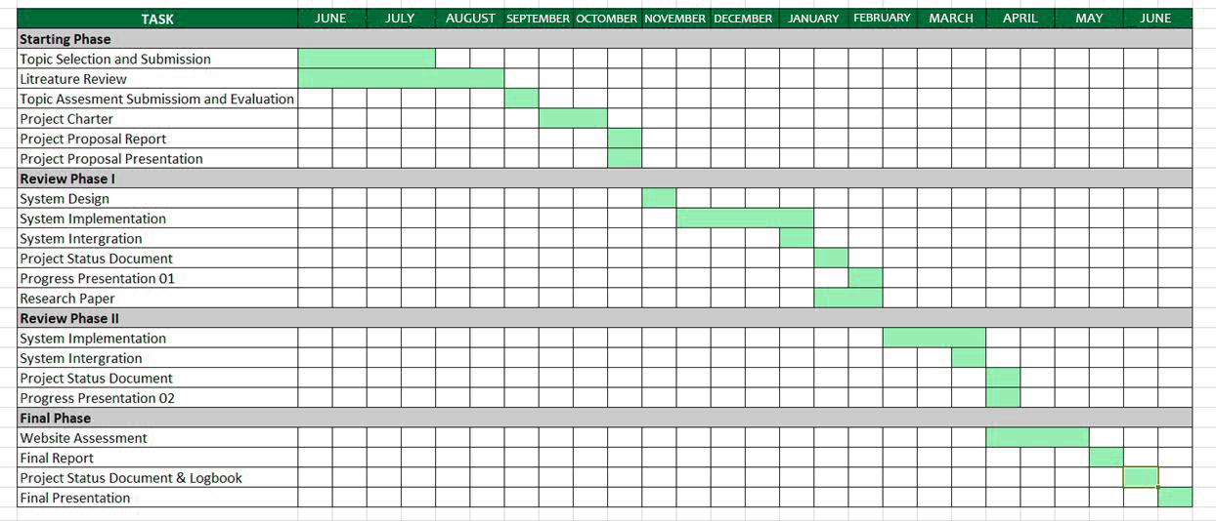
GRANT CHART

Slide 43
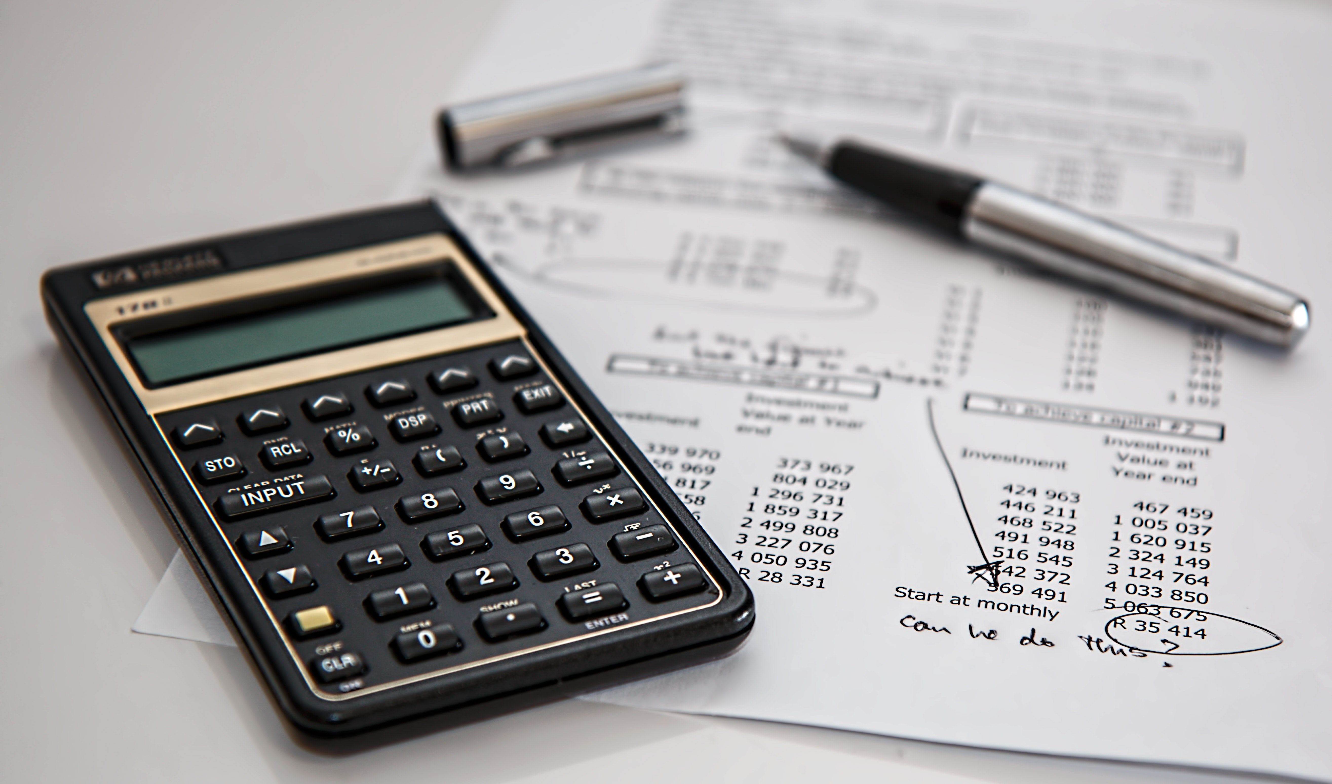
BUDGET
Travelling cost | Rs. 8000
Hosting Charges - Play store | Rs. 5000
Cloud service | Rs. 6000
Internet charges | Rs. 5000
Total | Rs. 24 000

Slide 44
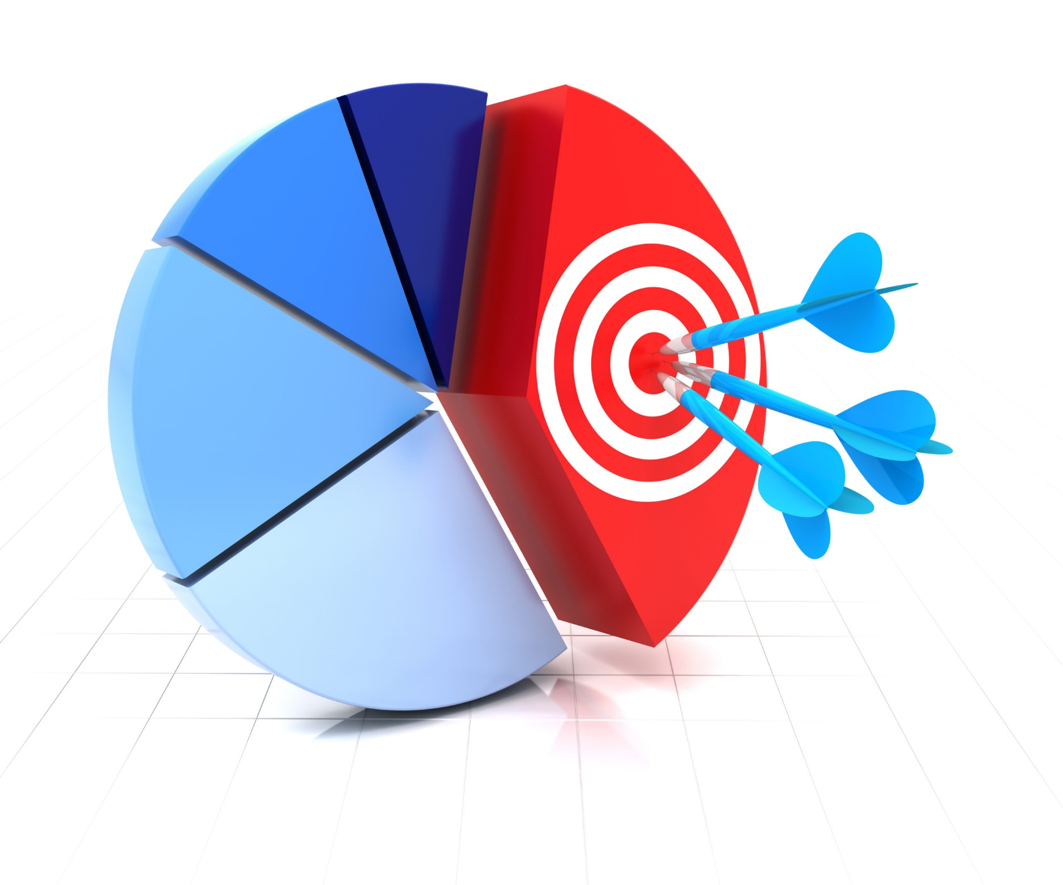
COMMERCIALIZATION
Target Audience- Stakeholders Those who broke up
Version
Commodity Version:
Identification of emotion
Relation build up tracking system
Real time notifications
Premium Version:
Can Enable AR Character
Severity level of tracking system
Severity level of councillor and other tips
Marketing plan
There is no limit in age for users
No need to advanced knowledge in technology

Slide 45
REFERENCES
W. Medhat et al.Sentiment analysis algorithms and applications: A survey
Ain Shams Engineering Journal
(2014)
https://ijcrt.org/papers/IJCRT2106002.pdf

Slide 46

THANK YOU

